Slide 1
Module 3: Lesson 3 MapReduce Concepts

Slide 2
MapReduce Explained Simply ☺
Our goal is to process HDFS files or (S3) objects as input and to produce HDFS files or (S3) objects as output
Why do this… to derive insight from a large volume of data impossible to explore manually or with standard data science tools and systems
So we write a program composed of several mandated or optional functions which is then distributed across a cluster
This program is generally referred to as a MapReduce job
The MapReduce framework distributes this program across the cluster for its functions to execute in parallel
An executing function of this program/job is referred to as a task
Functions (tasks) are called in a specific sequence to perform the programmer specified data processing activities

Slide 3
MapReduce Explained Simply ☺
So we start with some input, such as an HDFS file or (S3) object
Some part of the input file or object is assigned to an initial task to process… One file or object part per task
This part of the file or object is called a split… Usually, for HDFS files, a split corresponds to a block
These initial tasks executes one of the functions included in the program/job distributed across the cluster
This initial function is referred to as the Mapper
Each Mapper task (function), which executes in parallel with the others, is given data from the input split with which it is associated, one record/line at a time
The input to the Mapper function is a record from the split with which it is associated… But what is the format of that input?

Slide 4
MapReduce Explained Simply ☺
The MapReduce framework provides and accepts data to/from Mappers and other functions in a very standardized way
This is through the use of key value pairs, which we will write as
<key, value>
And which is provided to the Mapper function to represent the input record
Each record read from a split is passed to a Mapper as a key value pair
And the Mapper can output zero, one or more (intermediate) key value pairs for each input key value pair it is passed

Slide 5
MapReduce Explained Simply ☺
Each key value pair passed to the Mapper has the following general form
<offset, record-content>
In practice the key of the key value pair passed to the Mapper is an offset into the file and is usually ignored… we just care about the record-content
And often the record-content is passed as a string or some other simple format
The Mapper accepts an input key value pair of the above form, parses the record content
Then the Mapper performs some specific transformation on the value part, and generates zero or more key value pairs as output
The key value pairs output by the Mapper have the following general format
<app-specific-key, single-app-specific-value>

Slide 6
MapReduce Explained Simply ☺
The output of each Mapper is based on a partial view of the entire input HDFS file or S3 object… a single split view
But now we need to consolidate intermediate records from all of the Mappers together to create a summary or aggregate result
So another function must be coded in our program/job to accept intermediate output from Mappers and do the summary processing
This function/task is referred to as the Reducer…but the Reducer is not passed the exact output (key value pairs) produced by action of the Mappers
The MapReduce framework does some additional processing of the key value pairs output by Mappers before providing them as input key value pairs to the Reducers
This occurs during what is called the shuffle and sort step… the values associated with the same keys are grouped together into collections

Slide 7
MapReduce Explained Simply ☺
Here an example will be helpful…
Let’s say there are two Mappers and one Reducer function/task: the mapper task output the following simple key value pairs as follows:
Mapper1 -> <hi, 1> <there, 1>
Mapper2 -> <hi, 1> <you, 1>
During the shuffle and sort phase these key value pairs are reorganized into the following, note we using curly brackets to indicate a collection:
<hi, {1, 1}> <there, {1}> <you, {1}>
That is, all the values associated with the same key are grouped into a collection, and that collection becomes the value of the key value pair used as input to the reducer
The shuffle and sort does one more thing…it sorts the key value pairs to be provided as input to the Reducer(s) in order, by key (and NOT by value)

Slide 8
MapReduce Explained Simply ☺
So each key value pair passed to a Reducer has the following general form
<app-specific-key, {value1, value2, …}>
The Reducer accepts an input key value pair of the above form then performs some specific transformation and generates zero or more key value pairs as output
The key value pairs output by the Reducer have the following general format
<app-specific-key, single-app-specific-value>
These key value pairs are written to an output HDFS file or S3 Object

Slide 9
Important Facts About MapReduce
All instances of the Mapper function work independently and in parallel, including working on different machines of the cluster.
All instances of the Reducer function work independently and can work in parallel, including on different machines of the cluster.
The Shuffle stage represents (in part) a parallel sort, so Shuffle can also work in parallel on different cluster machines.
The Mapper function is often used on a machine where the data is stored. This allows reducing data transmission over the network.
A MapReduce job is always a full scan of all the data; there are no indexes or partial reads.

Slide 10
Important Facts About MapReduce
Viewed from a slightly different angle, MapReduce codifies a generic “recipe” for processing large datasets that consists of two stages
Map—First a user-specified computation is applied over all input records as splits) in a dataset. These operations occur in parallel and yield intermediate output
Reduce—Next the intermediate output is grouped and sorted by the framework and then aggregated by another user-specified computation
The programmer defines these two types of computations, and the execution framework coordinates the actual processing
Such a two-stage processing structure may appear to be very restrictive, but many interesting algorithms can be expressed quite concisely…
Especially if one decomposes complex algorithms into a sequence of MapReduce jobs.

Slide 11
Why ”MapReduce”?
Inspired by two functions form the Lisp programming language
Map(function, set of values)
Applies a function to each value in a given set
(map ‘length ‘(() (a b) (a b c))) -> (0 1 2 3)
To determine the length of each list in a set of lists
In MapReduce, a map function is applied in parallel to each split of an input data source and produces intermediate key-value pairs as outputs
Reduce(function, set of values)
Combines all values in a set together using a binary function
(reduce #’+ ‘(1 2 3 4 5)) -> 15
To sum up the numbers in a set
In MapReduce, a reduce function is responsible for aggregating or summarizing intermediate key-value pairs produced by multiple map functions to generate a final output

Slide 12
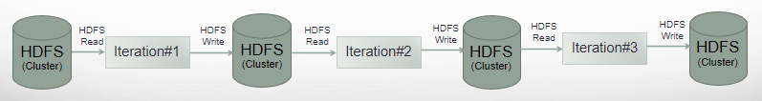
MapReduce Jobs
Each job in a job flow is independent of the previous one
Each job begins by reading from some persistent store (ex. HDFS), processing the data, and writing it back to a persistent store (ex. S3)
Job pipelines with numerous iterations (repeating jobs) result in significant IO overhead to the detriment of overall performance

Slide 13
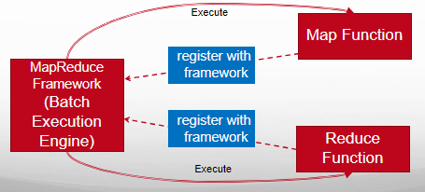
Programming by Extension Coding Using the MapReduce Framework
Most frameworks have a core of services and offer “plugin” capability for you to add custom code
These plugins are generally member functions that must accept specified input types and return specified output types
Framework users code these functions and register them with the framework
The MapReduce framework supports hooks for standard functions such as map, reduce and others

Slide 14
Dataset Abstractions From Block to Splits
Files in HDFS are divided into physical chunks call blocks where each block is a fixed size and stored as regular files in the local OS file system
But parallel processing engines and their related tools were designed to be decoupled from any specific file system
This allows these tools and parallel processing engines to work with S3, HDFS and other data stores
And it is especially useful as certain data stores, such as S3 objects, have no (user accessible) concept of blocks at all they are just sequences of bytes
So the question is… how is this decoupling is managed, and the answer is through the concept of splits

Slide 15
Dataset Abstractions Splits
Splits are logical segments of a data store (file, object, etc.) and present a byte-oriented view of the data
They represent references to stored data and not the data itself
With respect to HDFS split size usually correspond to block size
With respect to objects, splits represent fixed size and contiguous sequences of bytes (for S3 this is 64 MB)
In MapReduce actual splits are represented by subclasses of the InputSplit class such as FileSplit
Each MapReduce Mapper is assigned a split and processes the data within that split.

Slide 16
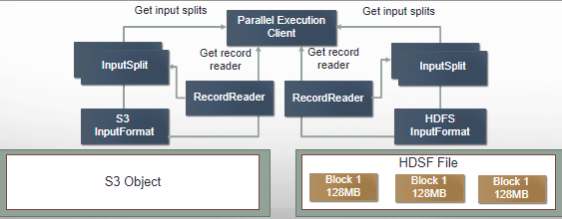
Dataset Abstractions Splits
Classes implementing the InputFormat interface provide the input processing for a MapReduce job
Instances of these classes divide up the input file(s) into logical chucks represented by instances of subclasses of the InputSplit class, each of which is then assigned to an individual Mapper
Instances of InputFormat classes also provide the RecordReader implementation to be used to obtain input records from a logical InputSplit for processing by the Mapper.

Slide 17
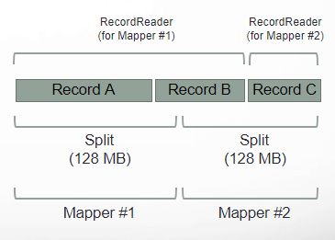
Dataset Abstractions Records
But Mappers and Reducers do not process arbitrary sequences of bytes but distinct records within the data
The RecordReader interface provides the mechanism for mappers to read and parse records from splits
Its implementing classes encapsulate the logic for decoding and extracting individual records from an underlying data format, such as text files, CSV files, or binary data
Cross-split record boundaries occur when a single logical record spans more than one split
The RecordReader is responsible for identifying and handling cross-split records

Slide 18
Data Representation Key Value Pairs
Most frameworks provide data to user member functions (plugins) and otherwise manage it
And this data may be of any type useful to the framework’s user
But this means the framework must have a means to hold and pass data of unknown types
The way most frameworks handle this is to place user data types in a “wrapper”

Slide 19
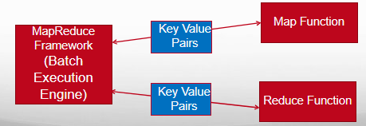
Data Representation Key Value Pairs
So the framework uses the wrapper as a means to handle and move data
To hold a wide range of user data types, this wrapper must be very generic
The MapReduce framework wraps data in key value pairs which form the basic data structure in MapReduce
Key value pairs are used to pass user data types between the plugin functions and the framework (and are used internal to the framework as well)

Slide 20
Data Representation Key Value Pairs
A key value pair is composed of two items:
A key, which is a unique identifier for some item of data
A value, which is the item of data itself
Keys and values may be primitives such as integers, floating point values, strings, and raw bytes, or they may be arbitrarily complex structures (lists, tuples, associative arrays, etc.).
Part of the design of MapReduce algorithms involves imposing the key-value structure on arbitrary datasets

Slide 21
Data Representation Key Value Pairs
The key and value can be either simple or complex types. For example, here are simple key value pairs
<“hello”, 5>
<”hello”, “there”>
Key value pairs can also be complex
<”hello”, list(1, 2, 3, 4, 5)> or equivalently <”hello”, {1, 2, 3, 4, 5}>
<struct(“a”, 5), “hello”>

Slide 22
Data Representation Key Value Pairs
For a collection of web pages, keys may be URLs and values may be the actual HTML content.
For a graph, keys may represent node ids and values may contain the adjacency lists of those nodes
In some algorithms, input keys are not particularly meaningful and are simply ignored during processing
While in other cases input keys are used to uniquely identify a data item (such as a unique record id)

Slide 23
The Big Picture of How MapReduce Works
Data Splitting
Input data is read from some persistent data store such as HDFS or S3 and divided into smaller chunks called splits, which are distributed across multiple machines in a cluster. This splitting enables parallel processing of the data, significantly improving overall performance.
Map Function
The map function is applied to each split independently. It processes the input data in the form of key-value pairs and transforms it into intermediate key-value pairs. The map function encapsulates the user-defined data processing logic.
Shuffle and Sort
The intermediate key-value pairs are shuffled and sorted based on their keys. This process ensures that all values associated with a particular key are grouped together, preparing the data for the reduce phase.
Reduce Function
The reduce function takes a key and a list of associated values as input. It combines these values to produce a single output value. The reduce function encapsulates the aggregation logic and determines how the intermediate data is summarized or transformed
Output Writing
The final output key-value pairs produced by the reduce function are written to a distributed filesystem or database. This output represents the final results of the MapReduce job and can be used for further analysis or applications.

Slide 24
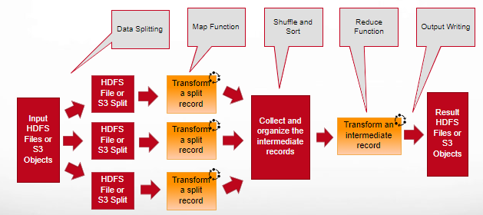
Parallel Batch Data Analysis

